Slide 1
IT Ticket Analysis
Presentation
This presentation analyzes IT support ticket data to uncover valuable insights and enhance service quality.
by Lakshmikantha S

Slide 2
Introduction and Objectives
1
Customer Satisfaction
2
Project Goals
3
Outcome
This project analyzes ticket data to assess agent performance, resolution efficiency, and employee satisfaction.
The goal is to improve IT support effectiveness and boost service quality for all users.
68% of customers abandon services due to poor support. This emphasizes the critical need for efficient IT support.

Slide 3
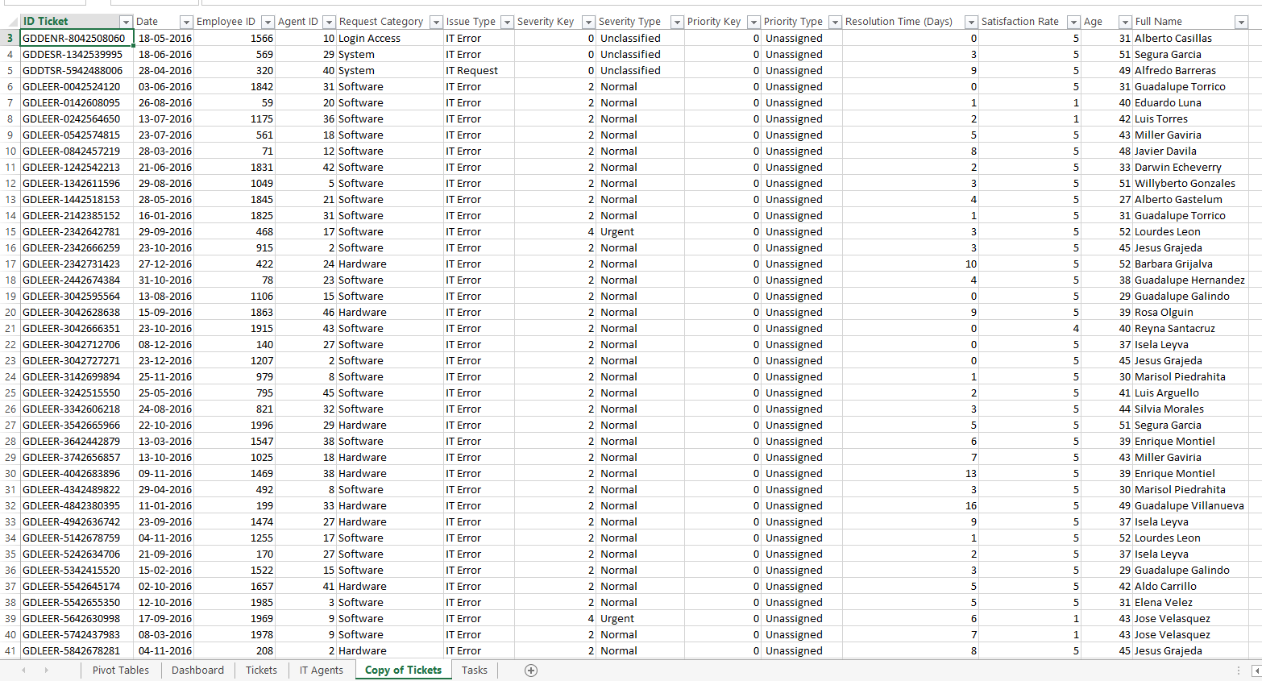

Data of it tickets

Slide 4
The provided data sheets present two main sets of attributes related to tickets and IT agents:
Ticket Data Sheet (first image):
Ticket ID: Unique identifier for each ticket.
Date: Date the ticket was logged.
Employee ID & Agent ID: Identifiers for the employee raising the issue and the IT agent assigned.
Request Category: Type of request (e.g., login access, system, software, hardware).
Issue Type: IT-related issues (e.g., IT Error, IT Request).
Severity & Priority Type: Levels of urgency and priority.
Resolution Time (Days): Time taken to resolve.
Satisfaction Rate: Employee satisfaction after issue resolution.
Age: Employee age.
Full Name: Employee’s full name.

Slide 5
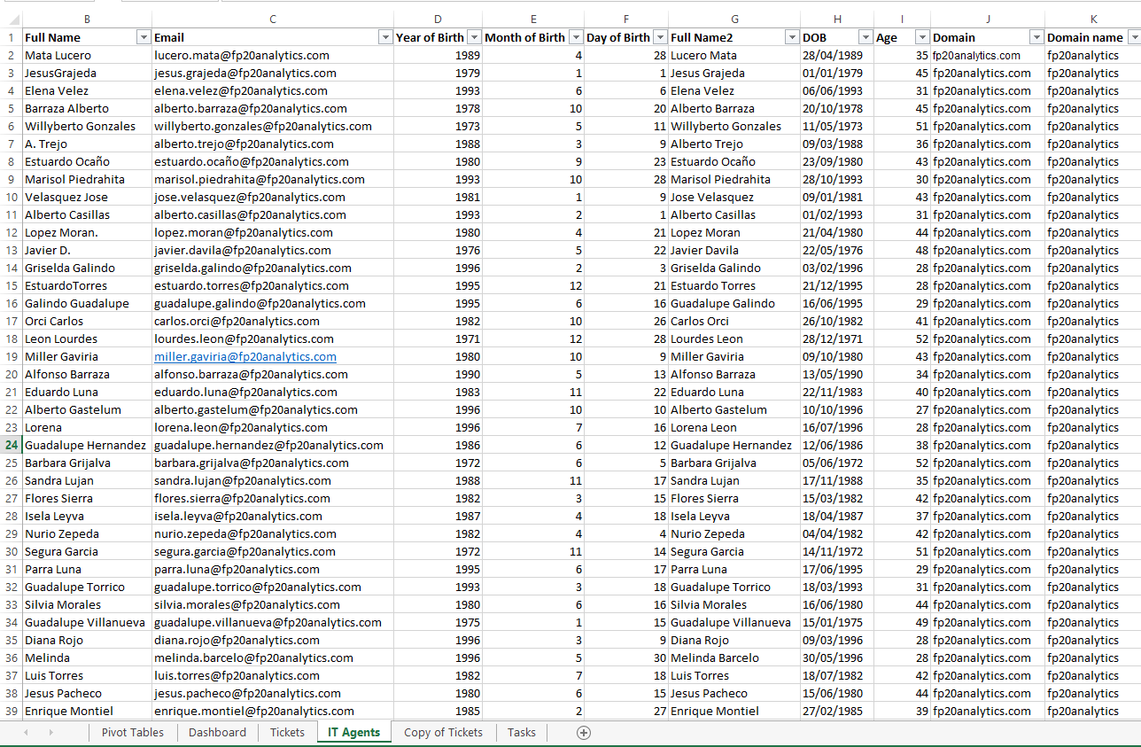
Data of it AGENTS

Slide 6
Full Name: Agent's full name.
Email: Email addresses of IT agents.
Year/Month/Day of Birth (DOB): Details about the birth date of each agent.
Age: Current age of agents.
Domain: Company's email domain.
Major factors in use are Ticket ID, Request Category, Resolution Time, and Satisfaction Rate from the ticket sheet, and Full Name, Email, and Age from the IT agent sheet. These factors seem central to the analysis of ticket handling and agent performance.

Slide 7
Data Structure and Quality
Ticket Data
Agent Data
Data Cleaning
Contains ticket IDs, categories, severity, priority, resolution times, and satisfaction ratings.
Includes agent identification, contact details, and demographic information.
Corrected spelling errors and standardized classifications to ensure data accuracy and consistency.

Slide 8
Ticket Volume Over Time
TICKET VOLUMES HAVE CONSISTENTLY INCREASED, INDICATING HIGHER DEMAND ON OUR IT AGENTS. TO ADDRESS THIS, WE NEED TO ASSESS AND ENHANCE OUR CURRENT TICKET MANAGEMENT SYSTEM FOR IMPROVED EFFICIENCY AND SUPPORT

Slide 9
Ticket by Satisfaction Rate
INVESTING IN ADVANCED TECH CAN BOOST TICKET RESOLUTION TIMES AND EMPLOYEE SATISFACTION WITH EFFECTIVE IMPLEMENTATION AND TRAINING, WE CAN FURTHER ENHANCE OUR ALREADY HIGH SATISFACTION RATES

Slide 10
Ticket by Severity Rate
WHILE THE MAJORITY OF IT TICKETS FALL INTO THE NORMAL CATEGORY, WE NEED TO FOCUS MORE ON THE MAJOR CATEGORY, AS IT LIKELY IMPACTS CRITICAL OPERATIONS AND REQUIRES PRIORITIZED ATTENTION AND RESOURCES.

Slide 11
Tickets By Priority
MOST TICKETS ARE CATEGORIZED AS HIGH OR UNASSIGNED, INDICATING A NEED FOR BETTER PRIORITIZATION AND RESOURCE ALLOCATION TO ADDRESS URGENT ISSUES AND MANAGE UNASSIGNED TICKETS MORE EFFECTIVELY

Slide 12
Resolution Time by Request Category
MOST IT TICKETS ARE RELATED TO LOGIN ACCESS AND SYSTEM ISSUES, HIGHLIGHTING POTENTIAL GAPS IN USER ONBOARDING AND SYSTEM STABILITY. TO ADDRESS THIS, WE SHOULD ENHANCE AUTHENTICATION PROCESSES AND IMPROVE SYSTEM RELIABILITY TO REDUCE THE FREQUENCY OF THESE COMMON ISSUES

Slide 13
Ticket by Resolution and Issue Type
TICKET RESOLUTION IS MORE FREQUENT IN THE IT REQUEST CATEGORY, BUT THE RESOLUTION TIME FOR THESEREQUESTS IS ALSO HIGHER. THIS INDICATES A NEED TO STREAMLINE THE REQUEST HANDLING PROCESS. IMPLEMENTING MORE EFFICIENT WORKFLOWS AND AUTOMATION TOOLS COULD REDUCE RESOLUTION TIMES ANDIMPROVE OVERALL EFFICIENCY

Slide 14
Distribution of employees based on satisfaction score
52% of employees have a top satisfaction score of 5, while 28% score 4, suggesting that around 80% of the workforce is performing well in terms of customer satisfaction. Only 2% score 1, indicating a small area of concern.

Slide 15
Distribution of employees based on Resolution Time
53% of employees resolve tickets within 0-4 days, and 33% within 5-9 days, highlighting that 86% of issues are resolved within 9 days. Very few employees exceed this range, suggesting strong overall efficiency in ticket resolution

Slide 16
Average Resolution Time And
Satisfaction rate By Age Group
THE AVERAGE RESOLUTION TIME AND SATISFACTION RATE FOR THE 32-36 AGE GROUP ARE BELOW EXPECTATIONS. TO ADDRESS THIS, WE SHOULD IMPLEMENT TARGETED TRAINING TO IMPROVE THEIR SKILLS AND PROVIDE ADDITIONAL RESOURCES OR SUPPORT TO ENHANCE THEIR PERFORMANCE AND CUSTOMER SATISFACTION.

Slide 17
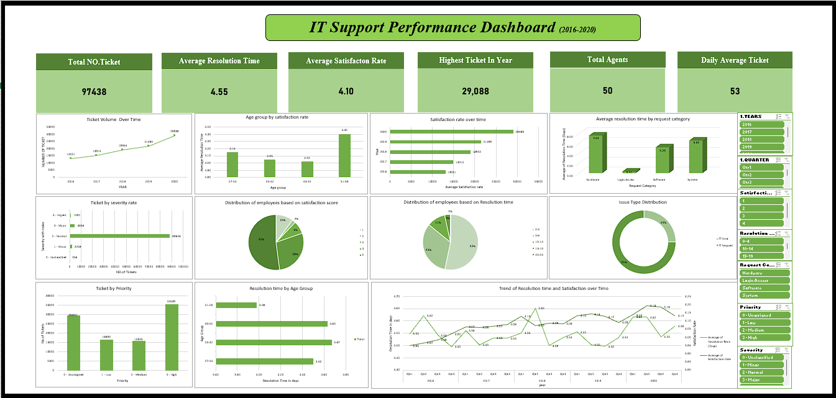
Ticket Volume Over Time

Slide 18
SUGGESTIONS
1.Increasing Ticket Volumes: Ticket volumes have consistently risen, signaling a higher demand on IT agents.We need to enhance our ticket management system to improve efficiency and support.
2. Tech Investment Benefits: Investing in advanced technology can boost ticket resolution times and employee satisfaction. Effective implementation and training will help enhance these benefits further.
3. Focus on Major Tickets: While most tickets are categorized as normal, we must prioritize the major category due to its critical impact on operations, requiring focused attention and resources.
4. High and Unassigned Tickets: Most tickets fall into high or unassigned categories, highlighting the need for improved prioritization and resource allocation to manage these effectively.
5. Common IT Issues: A significant number of tickets relate to login access and system issues, indicating potential gaps in user onboarding and system stability. Enhancing authentication processes and system reliability is essential.
6. IT Request Resolution Time: IT Request tickets are resolved frequently but take longer. Streamliningworkflows and implementing automation tools can reduce resolution times and improve efficiency.

Slide 19
7. High Resolution Times: Resolution times for hardware and system requests are notably high. Streamlining processes, investing in specialized training, and exploring automation tools can expedite these resolutions.
8. Age Group Performance Disparity: The 42-46 age group handles the majority of tickets, while the 32-36 age group handles the least. Targeted training and support for the younger group can balance workload distribution.
9. 32-36 Age Group Challenges: The average resolution time and satisfaction rate for the 32-36 age group are below expectations. Implementing targeted training and providing additional resources can enhance their performance.
10. Resource Allocation and Efficiency: Addressing high ticket volumes and improving resolution times requires better prioritization, efficient workflows, and strategic resource allocation to enhance overall IT support effectiveness.

Slide 20
CONCLUSION
To enhance IT support, we should:
Boost Efficiency: Invest in advanced technology to streamline ticket management and reduce resolution times.
Prioritize Critical Issues: Focus on major ticket categories and improve system stability
Optimize Resource Allocation: Improve prioritization and address high and unassigned ticket categories effectively.
Enhance Training: Provide targeted training and support, especially for age groups with lower performance.
Balance Workloads: Distribute tasks more evenly to maximize team effectiveness and satisfaction.
These steps will improve performance, efficiency, and satisfaction, preparing us for future demands

